Slide 1

SRES’
SANJIVANI COLLEGE OF ENGINEERING
KOPARGAON 423 603 (M.S.)
Department of
Electronics & Telecommunication Engineering
Academic Year: 2018-19.
MEGA PROJECT REVIEW
PROJECT GROUP NO: 31

Slide 2
PROJECT GROUP MEMBERS:
Maniyar Akib M. (Roll No: 101)
Muley Rasika R. (Roll No: 110)
Sheikh Masem M. (Roll No: 146)
PROJECT GUIDE: Prof. D. G. Lokhande

Slide 3
PROJECT TITLE:
Digitization of battery management system and charging of batteries using solar panels.
2. Domain / Field of specialization:
Power Electronics and drives / Battery System Engineering / Control System / IoT.
3. Project Definition:
The aim of this project is to digitalized the energy storing, dissipating, controlling and converting system (like batteries, Battery Management System and Solar Panel Respectively) by introducing concept of “Internet of Things” (IoT), Cloud Computing and displaying it on display (i.e. on Website / Local monitor LCD display) and make it simple to understand and manageable to the consumer.

Slide 4
4. Project objectives:
To monitor & control each cell in the battery pack by measuring its parameters.
To control and monitor the charge & discharge current going into and out of the battery pack.
To limit the overcharging and undercharging of cells.
To maintain safe operation of the pack.
To Monitor the cells temperature and control the thermal management systems to maintain the pack within a speciﬁed temperature range.
To efficiently convert the solar energy into the electrical one and preserving it.
To make all above objectives simply understandable and controllable by the consumer by introducing concept of “Internet of Things” (IoT), Cloud Computing and displaying it on display (i.e. on Website / Local monitor LCD display) .

Slide 5
5. Literature survey:
A review of completed and ongoing work on the “Battery Management System” and “Solar System” and “Internet of Things” have been taken from published and unpublished works from print and electronic sources. By referring this content we have observed some things that need to be added in the system which are
Digitization of the working of system.
Real time monitoring of the system.
Simplification in understanding and controlling of system for user.

Slide 6

5.1 “Battery System Engineering” by Christopher D. Rahn and Chao-Yang Wang, A John Wiley & Sons Publication year 2013.
This book describes the multidisciplinary area of battery system engineering by providing the background, models, solution techniques and system theory that are necessary for development of the advanced battery management system. Anyone who is interested in learning more about advanced battery system will benefit from this book.
By referring this book we got an tremendous amount of knowledge about battery management system. This book contents the designing of battery management system in consideration with the various battery pack parameters.

Slide 7

5.2 “SOLAR POWER ENGINEERING: PROCESSES AND SYSTEM” (2nd edition) by Soteris A. Kalogirou, Elsevier publication:
This book gives an introduction to an solar energy , its operation and how to design it. The material presented in this book covers a large variety of technologies for the conversion of solar energy to provide hot water, heating, cooling, drying, desalination and electricity.
from this book we got an information about solar panel system. How the solar panel works, its construction, operation. In addition to that we got an knowledge about different type of solar panel.

Slide 8
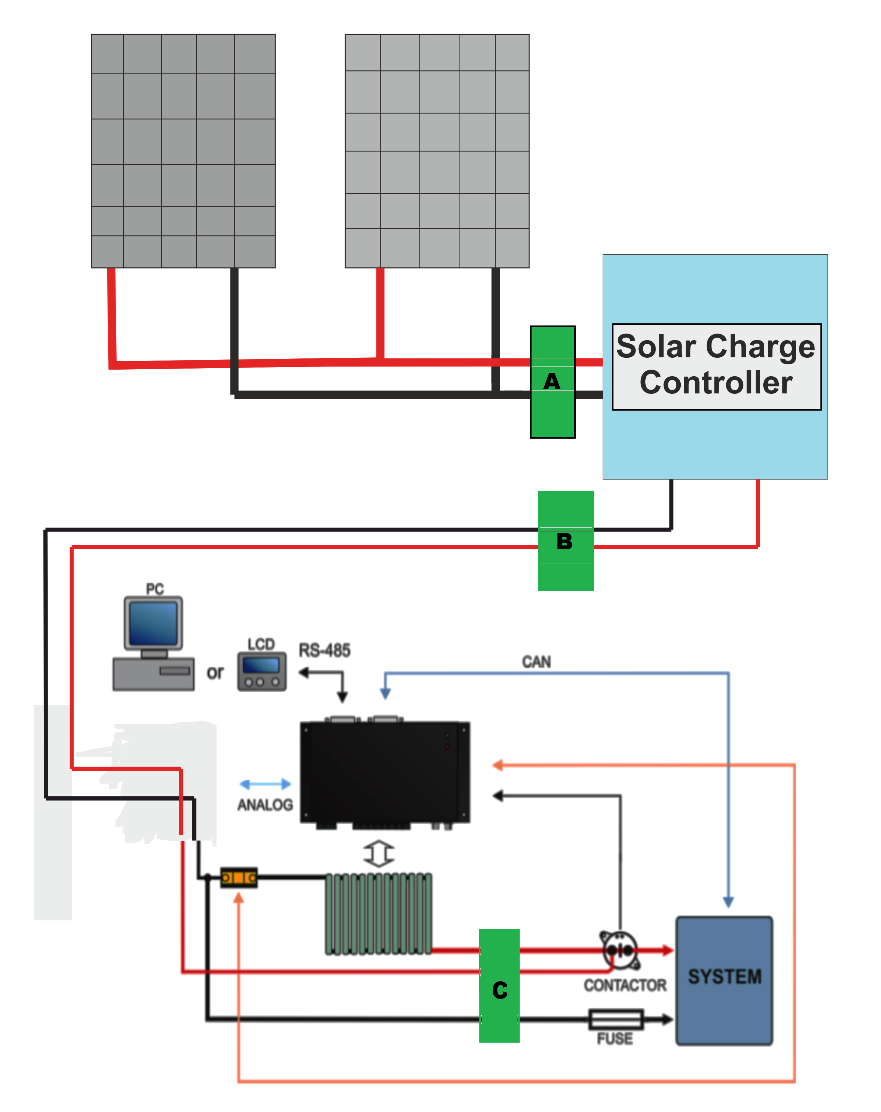
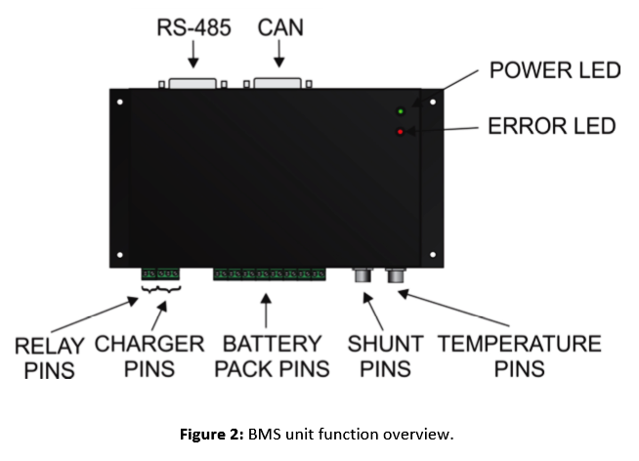
6. System overview

Slide 9
System Features:
1. BMS:
Robust and small design.
Single cell voltage measurement (0.1 – 5.0 V, resolution 1 mv) .
Single cell - under/over voltage protection.
Single cell internal resistance measurement.
SOC and SOH calculation.
Over temperature protection (up to 8 temperature sensors).
Under temperature charging protection.
Passive cell balancing up to 1.3 A per cell .
Shunt current measurement.

Slide 10
Galvanically isolated user defined multi-purpose digital input/output .
Programmable relay (normally open).
Galvanically isolated rs-485 communication protocol.
CAN communication .
PC user interface for changing the settings and data-logging.
Hibernate switch.
2. SOLAR PANELS:
Panasonic Module HIT - VBHN325SA16
Efficiency – 19.7%
Temperature Independent.
Having Water Drainage.

Slide 11
3. SOLAR CHARGE CONTROLLER:
NavSemi Energy IMAX40 (48v) MPPT Solar Charge Controller.
Maximization of Solar Energy Harvest.
Higher Power Conversion Efficiency.
Remote Monitoring.
Dual Voltage Operation (12/24V).
Integrated LCD Display.
LED Visual Indications.
High Voltage Protection.
Panel reversal Protection.
Battery reversal Protection.
Short Circuit Protection.
Open Fuse Protection.

Slide 12
Project h/w specifications:
BMS:
balance start voltage 3.5 V .
balance end voltage 3.6 V.
maximum diverted current per cell up to 1.3 (3.9 Ohm) A.
cell over voltage switch-off 3.8 V.
cell over voltage switch-off hysteresis per cell 0.015 V.
charger end of charge switch-off pack 3.6 V.
cell under voltage protection switch-off 2.2 V.
cell under voltage protection alarm 2.6 V.
cell under voltage protection switch-off timer 4 s.
cells max difference 0.2 V.
BMS maximum pack voltage 62.5 V.
BMS over temperature switch-off 50 °C.
cell over temperature switch-off 60 °.
under temperature charging disable -15 °C.

Slide 13
2. SOLAR PANEL:
Rated Power (Pmax)¹ : 325W
Maximum Power Voltage (Vpm) : 57.6V
Maximum Power Current (lpm) : 5.65A
Open Circuit Voltage (Voc) : 69.6V
Short Circuit Current (lsc) : 6.03A
Temperature Coefficient (Pmax): -0. 30%/°C
Temperature Coefficient (Voc) : -0. 174V/°C
Temperature Coefficient (lsc) : 1.82mA/°C
CEC PTS Rating : 301.7W
Cell Efficiency : 21.76%
Module Efficiency : 19.4%
Watts per Ft.² : 18.0W
Maximum System Voltage : 600V

Slide 14
Weight 40.81 Lbs. (18.5kg)
Dimensions LxWxH 62.6x41.5x1.4 in. (1590x1053x35 mm)
Cable Length +Male/-Female 40.2/40.2 in. (1020/1020 mm)
Cable Size / Type No. 12 AWG / PV Cable
Connector Type2 Multi-Contact® Type IV (MC4™)
Operating Temperature -40°F to 185°F (-40°C to 85°C)
3. SOLAR CHARGE CONTROLLER:
Maximum Power Handling (Wp): 2000
Maximum Voltage Open Circuit (V): 150
Operating Voltage Range(V): 60-120
Max Short Circuit Current (Isc): 20 A
Typical Battery Voltage (V): 48
Battery Low (V) [Red LED]: 43.2
Battery Low Alarm (V) [Yellow LED]: 45.6
Boost cut-off (V): 58.8
Float charge voltage (V): 54.4
Maximum charging current (A): 40
Self-consumption: <1.3 W OTHER

Slide 15
DS18B20 Sensor Technical specs:
Usable temperature range: -55 to 125°C (-67°F to +257°F)
9 to 12 bit selectable resolution
Uses 1-Wire interface- requires only one digital pin for communication
Unique 64 bit ID burned into chip
Multiple sensors can share one pin
±0.5°C Accuracy from -10°C to +85°C
Temperature-limit alarm system
Query time is less than 750ms
Usable with 3.0V to 5.5V power/data

Slide 16
References:
Christopher D. Rahn and Chao-Yang Wang, “Battery System Engineering”, John Wiley & Sons Publication year 2013 .
Soteris A. Kalogirou, “SOLAR POWER ENGINEERING: PROCESSES AND SYSTEM” , Elsevier publication
G.H. Kim and A. Pesaran,” Bat,tery Thermal Management System Design Modeling “, National Renewable Energy Laboratory, Conference Paper NREL/CP-540-40446 November 2006 .
https://www.researchgate.net/publication/224585947.
B. P. DIVAKAR, K. W. E. CHENG, H. J. WU, J. XU, H.B.MA, W. TING, K.DING, W.F.CHOI, B.F. HUANG, C.H. LEUNG, “ Battery Management System and Control Strategy for Hybrid and Electric Vehicle”, 2009 3rd International Conference on Power Electronics Systems and Applications. 15 April 2016.

Slide 17
Thank YOU …

